Slide 1




An Introduction to Jupyter Notebooks
by Bryan Cafferky
https://github.com/bcafferky/shared/tree/master/JupyterIntro

Slide 2



About Bryan Cafferky…
Microsoft Data and AI Solutions Enabler for Healthcare
Decades of IT Experience
Past Microsoft Data Platform MVP and Cloud and Data Center MVP
Author of Pro PowerShell for Database Developers
Experienced in health care, insurance, banking, and ecommerce
Founded and lead PASS Chapter The RI Microsoft BI User Group and The Boston Data Science Group
https://www.linkedin.com/in/bryancafferky
Subscribe to my YouTube Channel

Slide 3


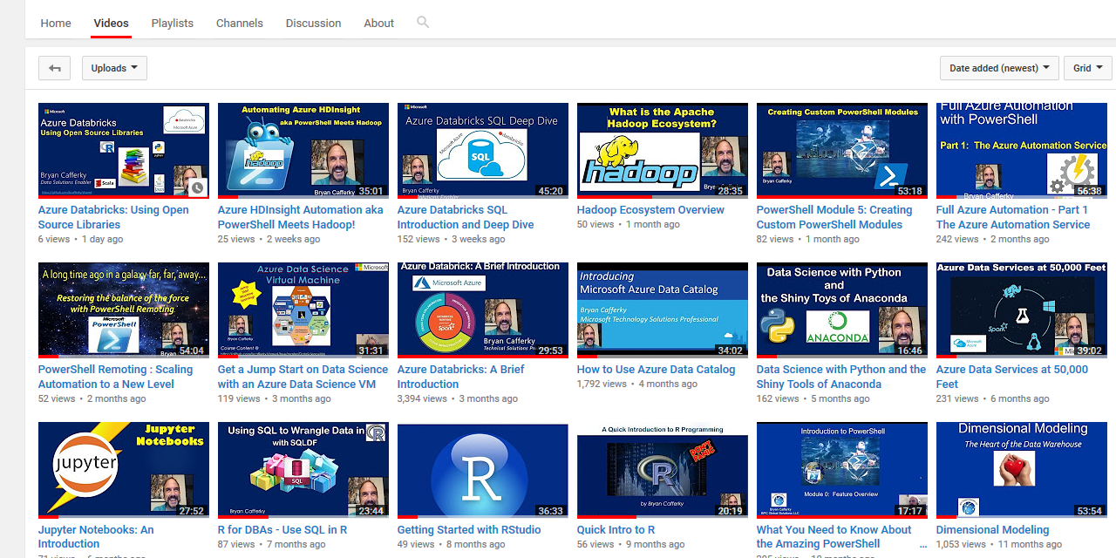
Subscribe to my YouTube Channel
https://www.youtube.com/c/BryanCafferky

Slide 4
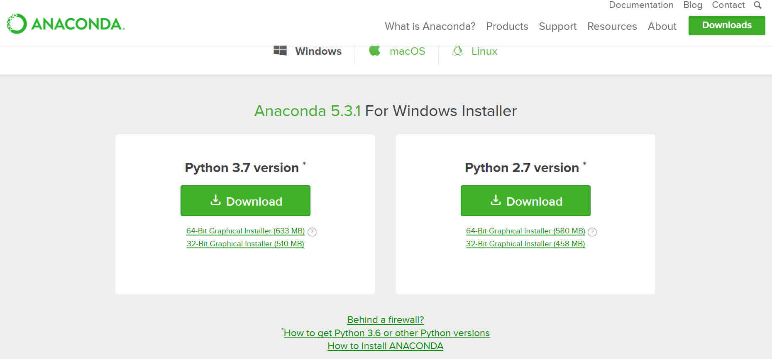
Getting Jupyter Notebook
Version Going Foward
https://www.anaconda.com/download/

Slide 5
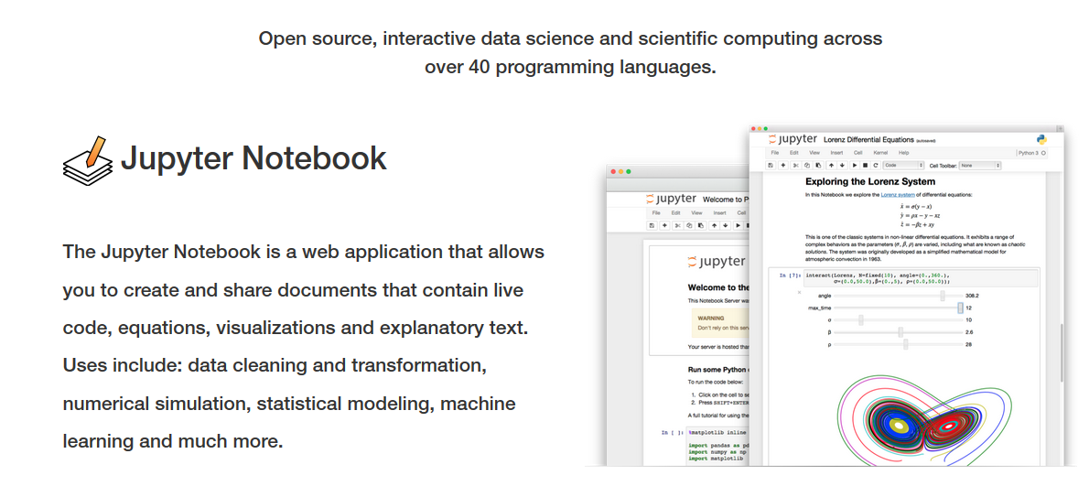
What is Jupyter Notebook?

Slide 6




When to Use Notebooks?
Teaching
Collaboration
Research
Exploration

Slide 7

Jupyter Notebook
Open Source
Written in Python – originally called IPython
Real time execution and rendering.
Many languages supported.
Supports Spark API (pySpark, SparkR, SparklyR)
Can share via GitHub, JupyterHub, and Azure.
Built-in Viewer Support in GitHub.

Slide 8
What’s in a name?
Emphasizes multi-language support.
Jupyter
R
Julia
Python

Slide 9
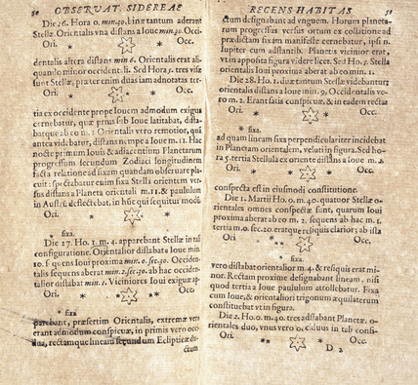
Why Notebook?
From Galileo’s Notebook –
Drawing’s of Jupiter’s satellites.

Slide 10
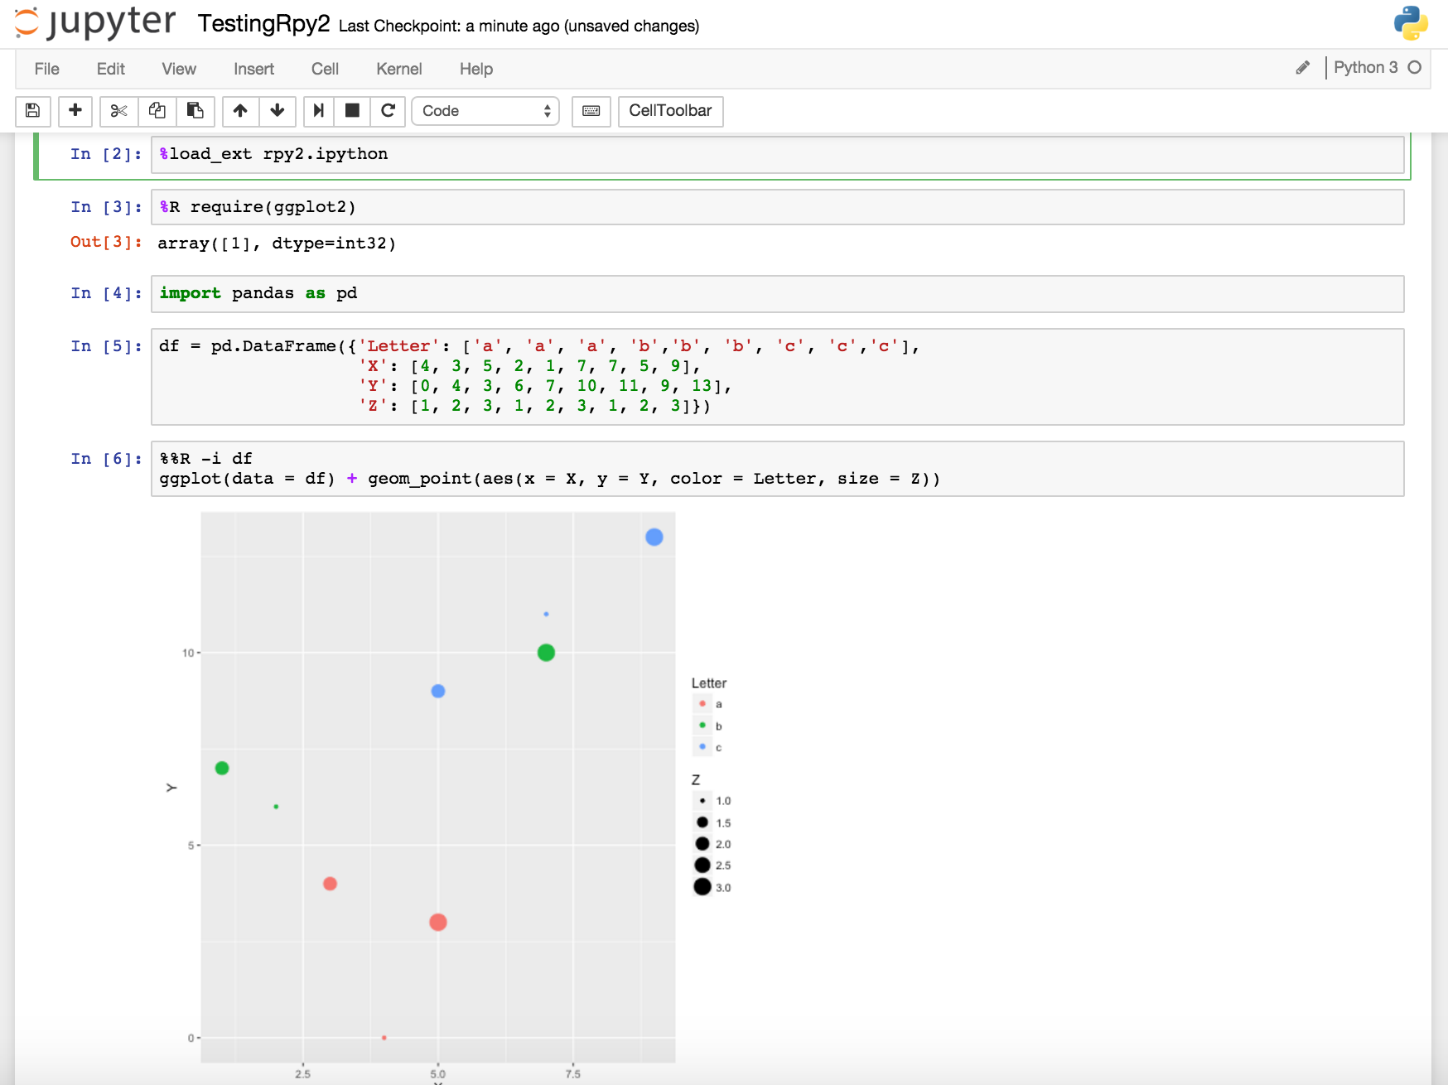
What is Jupyter Notebook?
Execute the cell
Command Prompt called a cell
Code executes in real time.
Can go back, edit and re-run cells.
Like a cross between a command line and Excel spreadsheet.
Rich visualizations rendered inline.

Slide 11
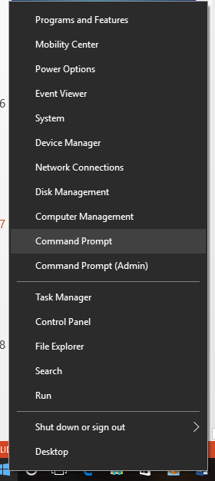
Starting Jupyter Notebook
Start the command shell.
Included with the Python Anaconda Distribution
https://www.anaconda.com/download/

Slide 12
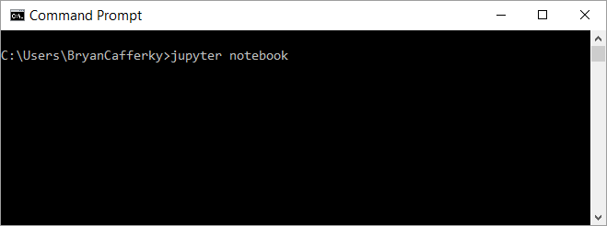
Installing Jupyter Notebook
Start the Jupyter Notebook
Windows Command Prompt
Note: The notebook starts pointing to the folder from where the notebook was started.

Slide 13
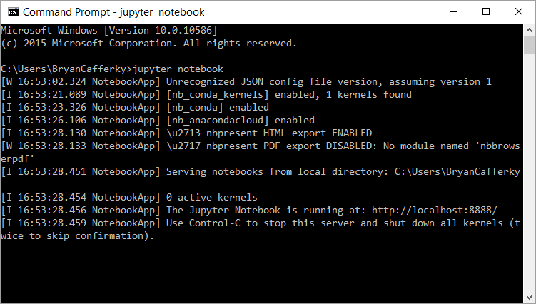
The Jupyter Server Running

Slide 14

Azure Notebooks
Maximize Notebook Value
https://notebooks.azure.com/

Slide 15
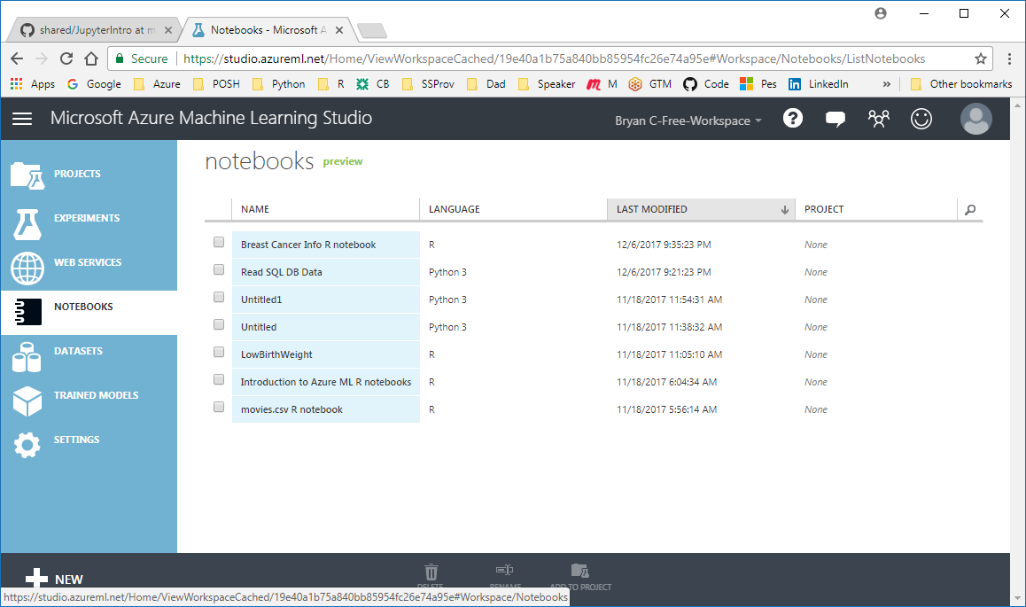
Azure Notebooks in ML Studio
https://studio.azureml.net/

Slide 16
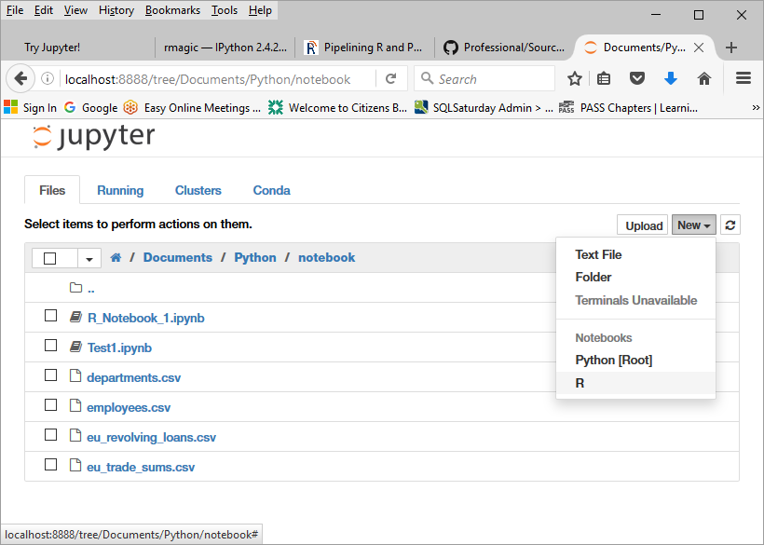
A First Look at a Notebook
Select New and the kernel, i.e. R

Slide 17
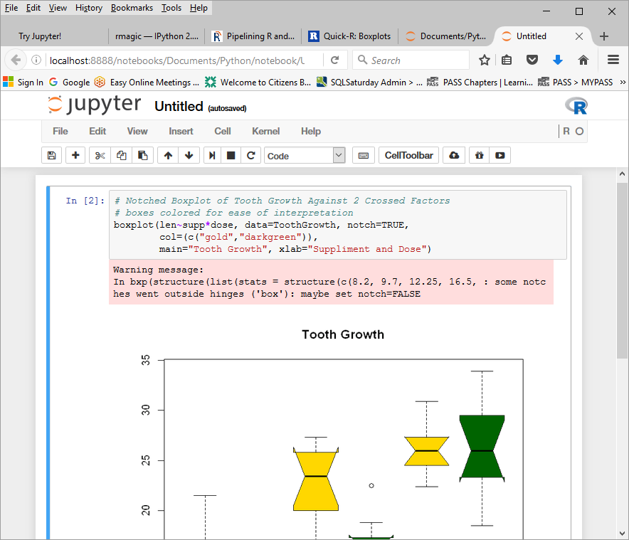
A First Look at a Notebook
Kernel Running
Enter R code and press Shift + Enter
Or
Click on

Slide 18
The Cell Toolbar
Save Notebook
Cut Cell
Copy Cell
Move Cell Down 1
Stop Cell Execution
Insert Cell
Paste Cells Below
Move Cell(s) Up 1
Run Code in Selected Cell(s)
Restart the Kernel
Set Cell Content Type

Slide 19
Exploring Jupyter…
New notebook
Sample notebooks
Python
R
Cell Magic
Widgets

Slide 20
http://jupyter.org/
Documentation
Free notebook play area

Slide 21
Use R and Python Together…
Loads R Python Extension
%R to run R code in the cell
Default language is Python 3
R ggplot call passing data frame, df, from Python
%%R defines data to be passed between R and Python:
-i = Python to R
-o = R to Python

Slide 22
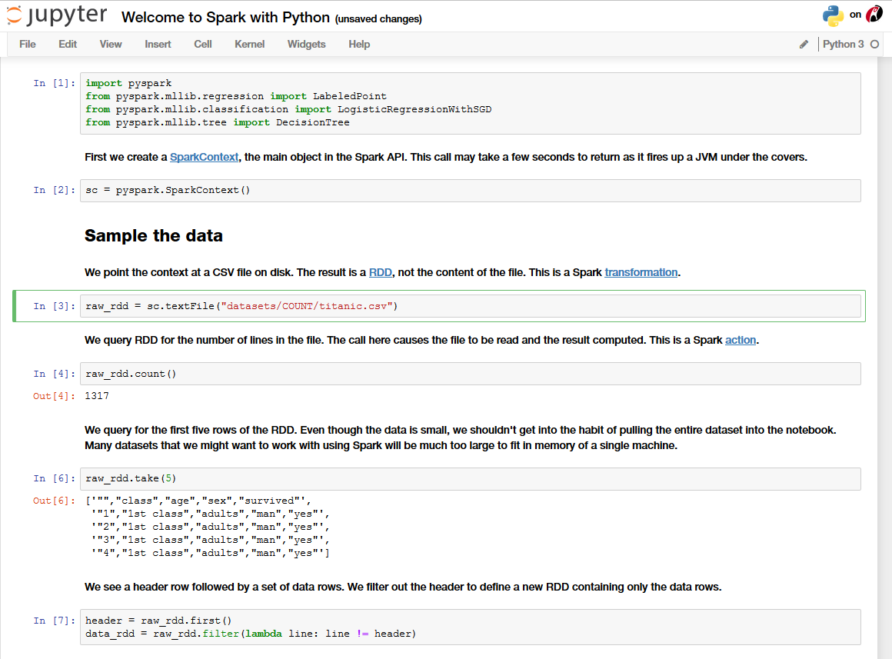
Accessing Spark with pyspark…
Import pyspark module
Set the Spark context
Resilient Distributed Dataset
Point context to HDFS file
Reads the data in Spark
Sample the data

Slide 23
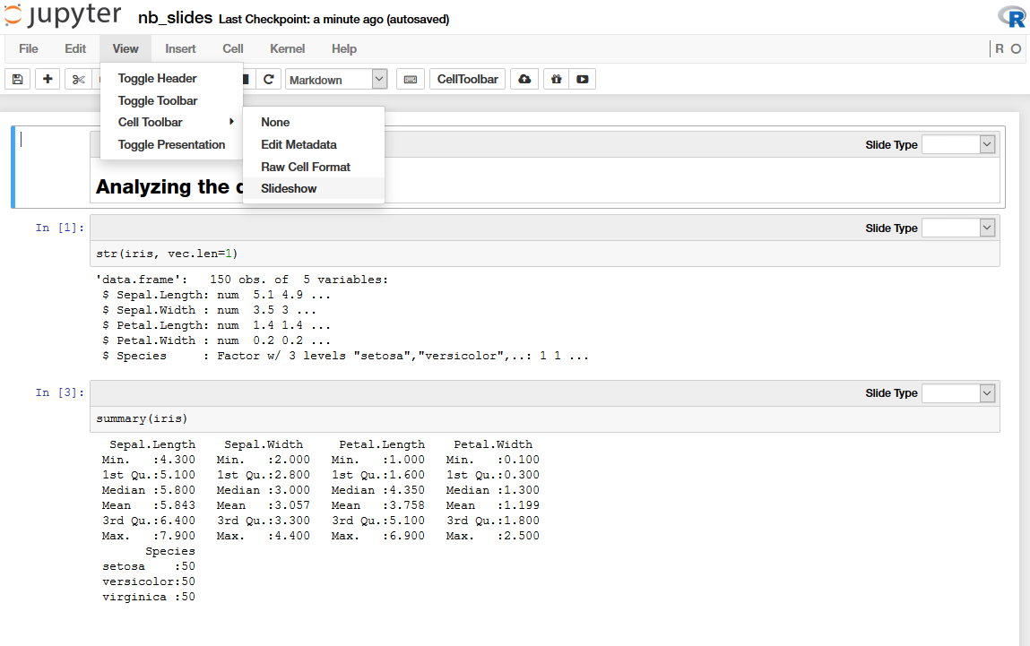
Presentations from Jupyter…
Switch to Slideshow Mode
Organize Slides

Slide 24
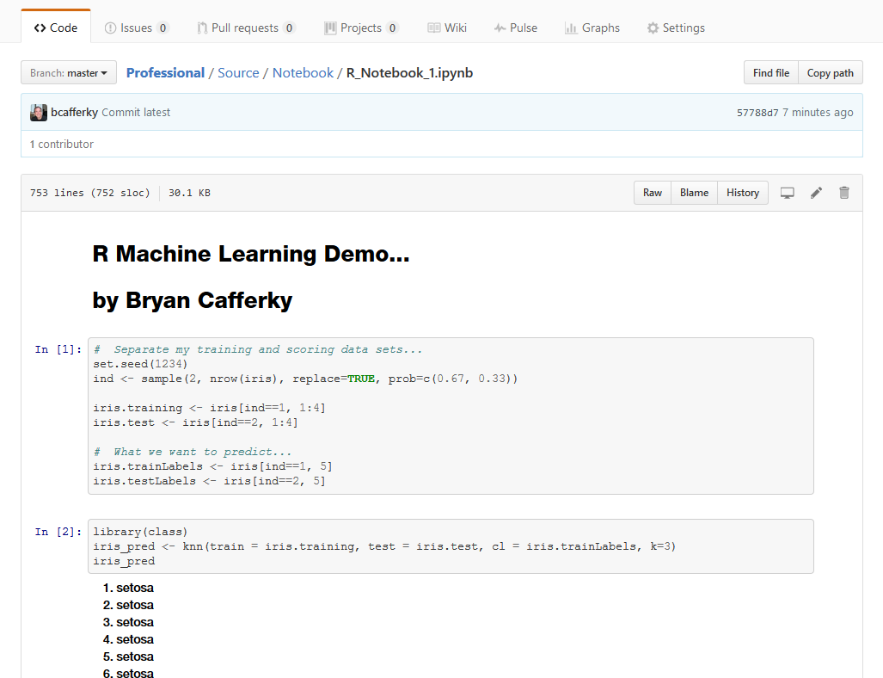
Github Renders Notebooks Automatically…

Slide 25
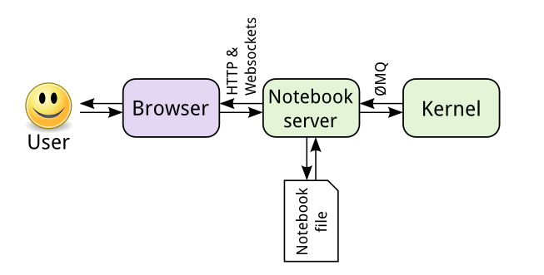
Kernel Architecture
JSON format
Can be many kernels:
Python
R
Julia
Ruby
Perl
PowerShell
http://jupyter.readthedocs.io/en/latest/architecture/how_jupyter_ipython_work.html

Slide 26
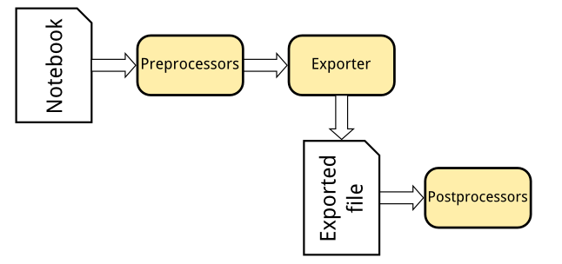
Flexible Notebook Conversions
nbconvert
Formats include:
HTML Slides
PDF
Markdown
Script
http://jupyter.readthedocs.io/en/latest/architecture/how_jupyter_ipython_work.html

Slide 27
Competition
RStudio R Notebooks
Apache Zeppelin Notebooks
Databricks Notebooks

Slide 28
Wrapping Up
Teaching
Collaboration
Research
Exploration

